Slide 1
KHATRA ADIBASI MAHAVIDYALAYA
P.O- Khatra, Dist.-Bankura, West Bengal, Pin-722140
Name of the Teacher- Tithi Roy
Class- Semester – IV
Subject- Physical Education
Course Tittle Health Education & Complete Wellness
Topic- Wellness
Session: 2020-21

Slide 2
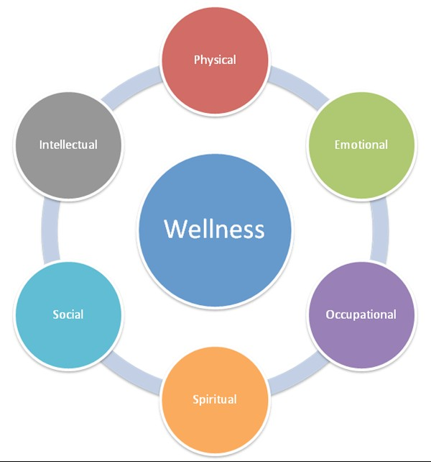
Top 10 Causes of Death
✦ Heart Disease ✦ Cancer ✦ Lung Disease ✦ Stroke
✦ Accidents ✦Alzheimer's Disease ✦Diabetes ✦Kidney Disease
✦Influenza/ Pneumonia ✦Suicide

Slide 3


How would you define
Health is a state of complete physical, mental, and social well-being and not merely the absence of disease.
In other words, just because you feel okay doesn't mean you are okay!

Slide 4
How would you define wellness?
Wellness is the
interactive process of becoming aware of and practicing healthy choices to create a more successful & balanced life
You have to know and understand how to become “well” before you are “well”

Slide 5
Behaviors that promote wellness
Being a smart consumer
Exercising at least 3 times per week for 60 minutes
Eating a variety of foods from all the food groups
Eating a diet low in fat, cholesterol & sodium
Learning to control anger & aggression
Having fun – taking time for yourself to play/relax
Avoiding alcohol, drugs & tobacco
Being in a positive environment – surrounded by good role models, good people, good social life

Slide 6

Benefits of wellness
Stronger heart, body and mind
Less stress
Better able to deal with stressful situations
Increased life expectancy & better quality of life
Lower cholesterol
Better/more positive self-esteem
Easier to meet new people and socialize

Slide 7

Characteristics of a wellness lifestyle...
Strong sense of personal responsibility
Exceptional physical fitness
Positive outlook
Joy in life & openness to new discoveries about the
meaning and purpose of life

Slide 8

Components of Wellness
Social
Physical
Psychological
Intellectual
Environmental
Spiritual

Slide 9

Social Wellness
The ability to meet new people of all ages and interact with folks you may not know that well

Slide 10

Physical Wellness
The ability to go
through your day and still have enough energy to do other activities
Being physically fit with a strong heart and body

Slide 11

Psychological Wellness
Accepting your emotions & feelings, realistically and being able to evaluate your limitations, working through problems, setting goals

Slide 12

Intellectual Wellness
Creative & stimulating mental activities, using available resources to expand knowledge & skills

Slide 13

Environmental
Ability to care for the environment, knowing its' resources and how to take care of it

Slide 14

Spiritual Wellness
Exploring the meaning of life Asking; who am I? Why do I exist?
Appreciating the beauty of your surroundings

Slide 15
Wellness Wheel
Read each of the statements carefully and decide if
the statement is never true, sometimes true, usually true, very often true or always true
When finished answering the questions, color in the spaces on the wheel, starting at the inside and working out. Color in the number of spaces that matches your answer.
After coloring the wheel, answer the questions that follow to interpret your results.

Slide 16
Reference
Essentials of Physical Education
By
Ajmer Singh, Jagdish Bains, Jagtar Singh Gill, Rachhpal Singh Brar

